Slide 1
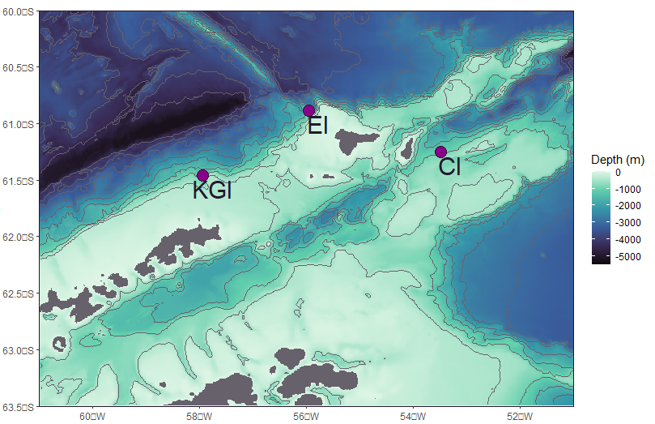
mCDW
Antarctic Circumpolar Current
TWW/WSW
BC/TBW/BSW
Antarctic Coastal Current
PF

